Slide 1
More Data Types
Fundamentals of Python Programming Chapter 4

Slide 2
Chapter Content
Strings
Lists
Tuples
Iterations

Slide 3
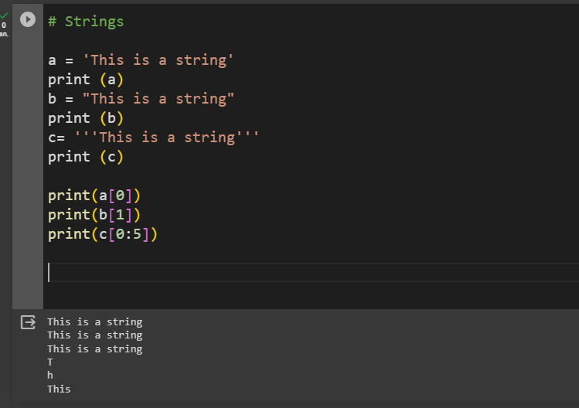
Strings
A string is a sequence of characters that can be a combination of letters, numbers, and special characters. It can be declared in python by using single quotes, double quotes, or even triple quotes. Strings are immutable, i.e., they cannot be changed. Each element of the string can be accessed using indexing or slicing operations.

Slide 4
Type Conversions
To convert int, float and string types to each other, we use
float()
int()
str()
Methods.
Note that in order to convert one type to another, variable must be compatible for converted type.

Slide 5
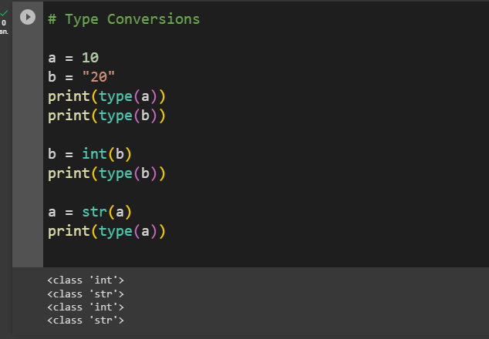
Type Conversions in Code

Slide 6
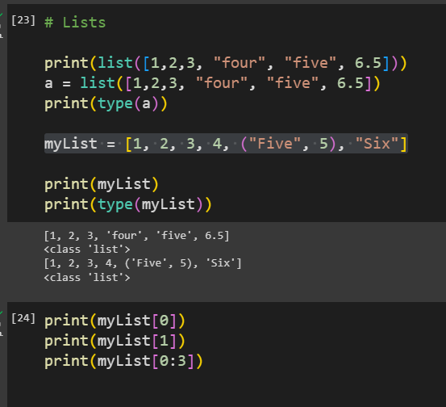
Lists
Lists are sequenced data types. In Python, an empty list is created using list() function. They are just like the arrays declared in other languages.
But the most powerful thing is that list need not be always homogeneous. A single list can contain strings, integers, as well as other objects.
Lists are mutable, i.e., they can be altered once declared.
The elements of list can be accessed using indexing and slicing operations.

Slide 7
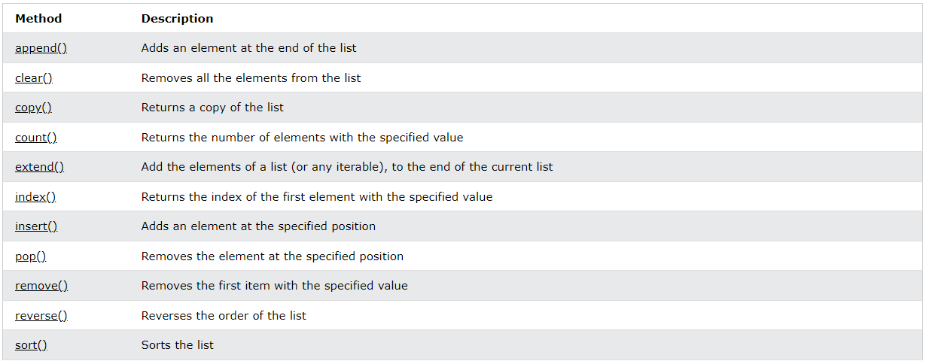
LİST METHODS

Slide 8
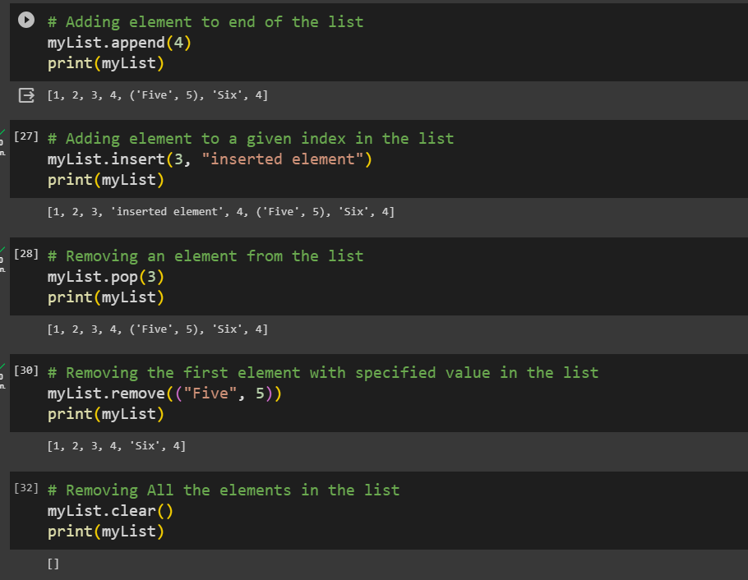
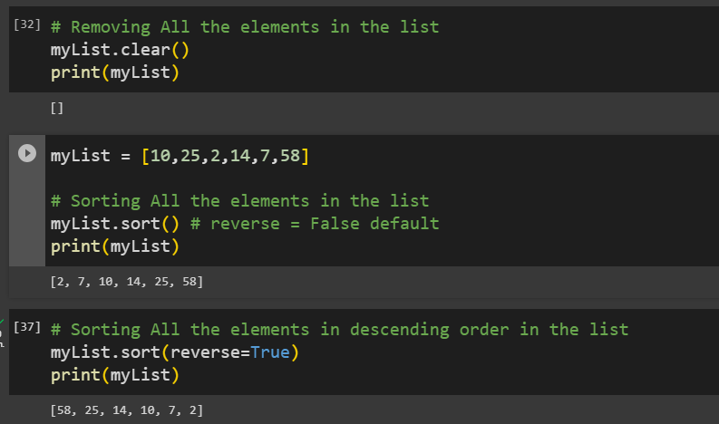
List Methods in Code

Slide 9
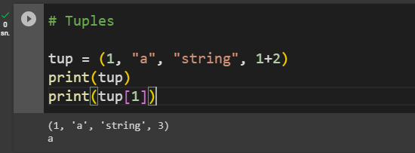
Tuples
A tuple is a sequence of immutable Python objects. Tuples are just like lists with the exception that tuples cannot be changed once declared. Tuples are usually faster than lists.

Slide 10
Sets
A Set in Python programming is an unordered collection data type that is iterable, mutable and has no duplicate elements. The major advantage of using a set, as opposed to a list, is that it has a highly optimized method for checking whether a specific element is contained in the set
We cannot assign or change a value once the set is created. We can only add or delete items in the set.
Since sets are unordered, we cannot access items using indexes as we do in lists. Python sets cannot have a duplicate value and once it is created we cannot change its value.

Slide 11
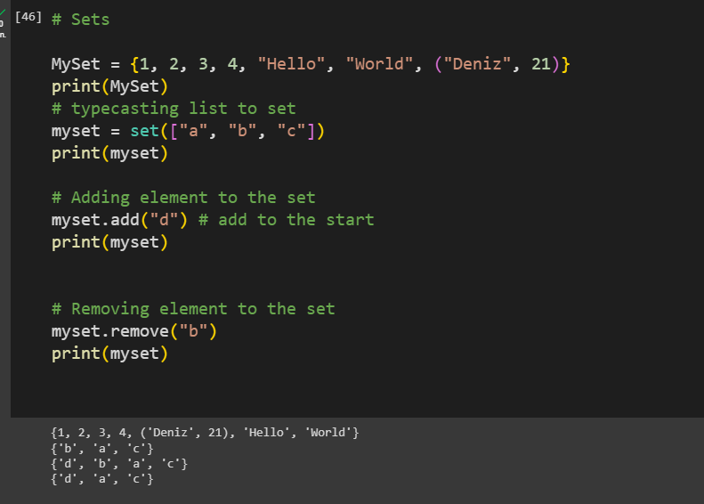
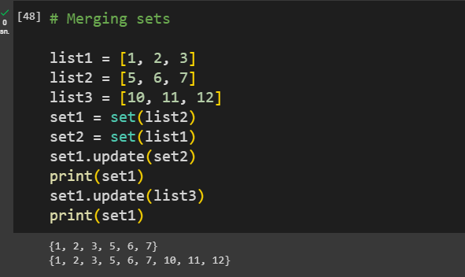
Sets ın code

Slide 12
dıctıonarıes
A dictionary in Python is a collection of key values, used to store data values like a map, which, unlike other data types holds Key-value only a single value as an element.

Slide 13
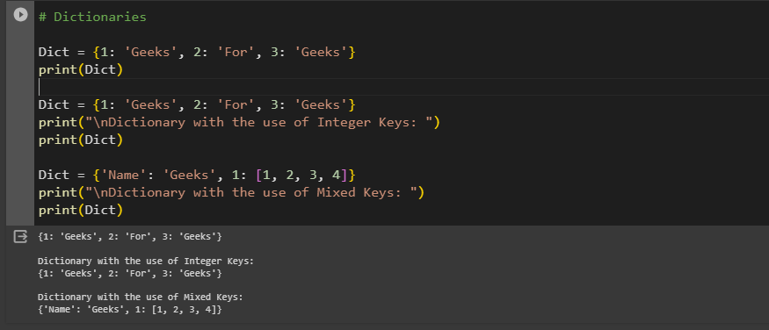
Dıctıonarıes ın code

Slide 14
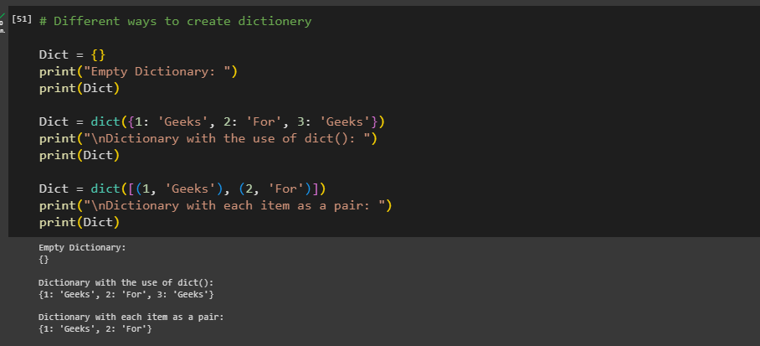
Dıctıonarıes ın code

Slide 15
References
https://www.geeksforgeeks.org/python-programming-language/#python-operators

